Slide 1
Analysis and Visualization of Pathogen Sequence Data
Trung Hoang, Tosika Fegade, Hoa Nguyen, Steven Khoa, Joshua Boisvert

Slide 2
Background
Is there any significant correlation between different subtypes of SARS-CoV-2 and the listed metadata for the sequences found on GISAID EpiCoV?
Using the SARS-CoV-2 sequences from GISAID, we wanted to build and visualize trees for each metadata category (location, gender, age)
Once we built a metadata-annotated tree, the goal was to use some tree-traversal algorithms to develop some metrics based on our results
The idea here is to break down the tree into clusters based on clade topology, then count how many metadata categories belong to each cluster
Notes:
@Josh

Slide 3
Related Work
Studying confirmed vs. actual cases at a given time
Signal processing/heuristics to model the spread of COVID-19 across different countries/regions
Coming up with meaningful tools/metrics to visualize large phylogenetic trees
Bingxin Lu, Louxin Zhang & Hon Wai Leong, BMC Genomics, “A program to compute the soft Robinson-Foulds distance between phylogenetic networks”
Notes:
Josh
Other resources -
C. Colijn, G. Plazzotta, Systematic Biology, “A Metric on Phylogenetic Tree Shapes”
Nikola Jovanovic, Alexander S Mikheyev, Nucleic Acids Research, “Interactive web-based visualization and sharing of phylogenetic trees using phylogeny.IO ”
Oscar Robinson, David Dylus, Christophe Dessimoz, “Phylo.io: interactive viewing and comparison of large phylogenetic trees on the web”

Slide 4
Dataset
Covid-19 Dataset on GISAID:
Today: 41,000 sequences
Early May: 16,000 sequences
Used for constructing trees
Covid-19 metadata on nextstrain github repo (also on GISAID website):
Used for trees labeling, tree visualization
Notes:
Trung

Slide 5
Data Preprocessing
We only considered data from “human” hosts with known “age”, “sex”, and “country”
Filtered the data set and its metadata to 8,000 sequences (using Python)
If we do with current dataset (41,000), it would be 13,000 sequences
Sequence Alignments are done using MAFFT (CIPRES):
Takes 6 hours
Trees were created using both RAxML (CIPRES) and FastTree (Multithreaded version)
Fast Tree takes 7 hours, RAxML takes 2-3 days
Repo: https://github.com/trung-hn/covid-19
Notes:
Trung

Slide 6
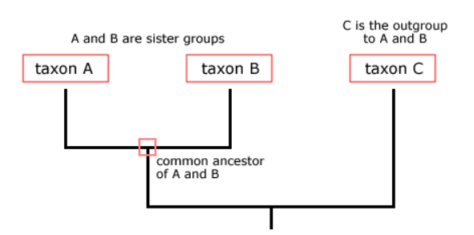
Phylogenetic Tree
A phylogenetic tree is a diagram that represents evolutionary relationships among organisms. Phylogenetic trees are hypotheses, not definitive facts. The pattern of branching in a phylogenetic tree reflects how species or other groups evolved from a series of common ancestors.
Types :
Some tools - ViPR (Metadata-driven Comparative
Analysis Tool), ETE toolkit, iTOL, CLC Main workbench,
etc.
"cladogram" suggests that the lengths of the branches in the diagram are arbitrary, while in a "phylogeny," the branch lengths indicate the amount of character change.
For our purposes here, the important things to remember are that organisms are related and that we can represent those relationships with tree structures.
Notes:
Tosh
cladogram is a type of phylogenetic tree that only shows tree topology—the shape indicating relatedness. Cladograms are concerned with the way organisms are related to common ancestors through shared characteristics.
A phylogram, on the other hand, has branch distance proportional to evolutionary distance, whether based on genetics or characteristics.

Slide 7
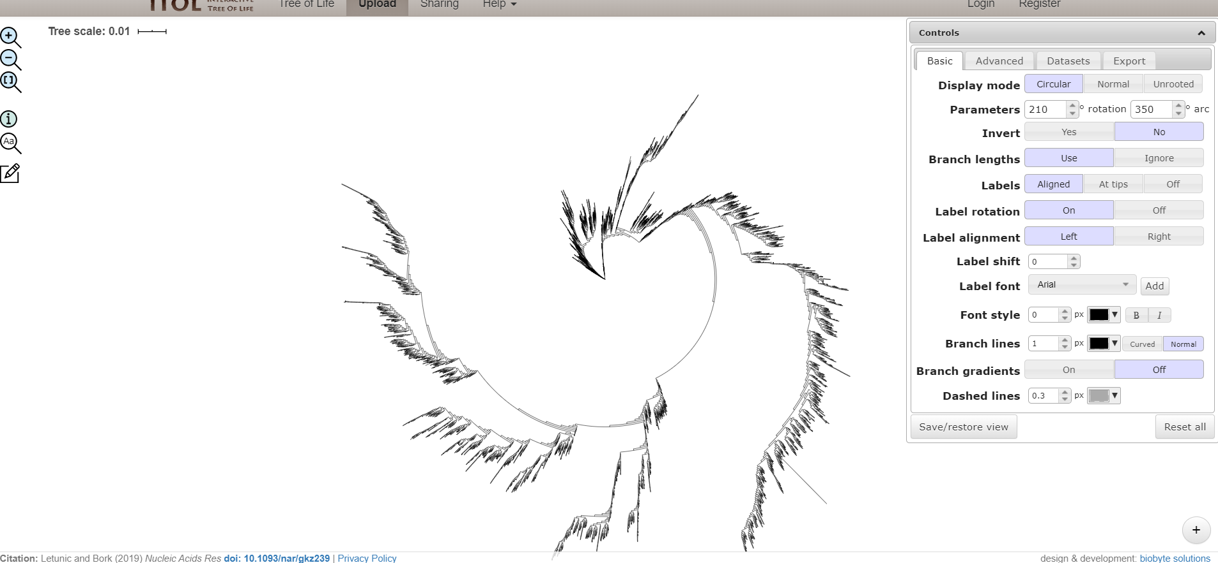
Trees Results - iTOL
Notes:
Interactive Tree Of Life is an online tool for the display, annotation and management of phylogenetic trees.
Tosh

Slide 8
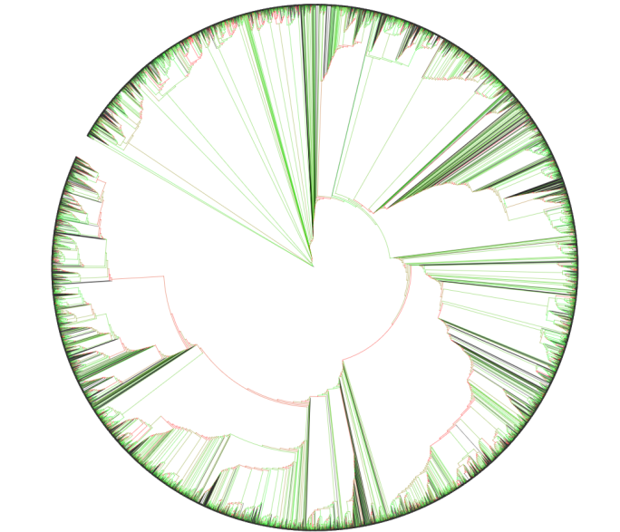
If a tree contains bootstrap information, or other metadata (such as various MrBayes metadata fields), these can be visualized by selecting Display under Bootstraps / metadata section of the Advanced controls tab.
The metadata can be visualized in 4 different ways:
Symbol: select the shape type, minimum and maximum size and the color.
Text: values will be displayed as text labels on the branches. Font size, numeric style and position of the label can be adjusted.
Color: tree branches will be colored according to their metadata values and the color gradient defined in the control box. For non-numeric metadata sources, colors will be assigned automatically.
Width: tree branch widths will be set according to their metadata values. Minimum/maximum widths selected will be used as the widths for the branches with minimum/maximum metadata value
Dataset option can be used to add Metadata but free trial supports only 5 entries for tree.
Notes:
ViPR (Virus Pathogen Resource) and ETE Toolkit
Tosh

Slide 9
Trees Results - Qiagen CLC Workbench
CLC Main Workbench 20.0.4 Windows, macOS and Linux May 12, 2020 This software is for research purposes only.
Phylogenies :
QIAGEN CLC Main Workbench allows for creation and visualization of phylogenetic trees and associated metadata. It is easy e.g., to find the optimal statistical approach by model testing and visualize imported metadata on tree topology, at high quality, ready for publication.
There are options to easily modify tree layout and color scheme. Also tools for e.g., generating phylogenetic trees using K-mer based tree construction and for Maximum Likelihood analysis of amino acid alignments are available.
Metadata refers to information about data. In the context of the CLC Main Workbench, this usually means information about samples. For example a set of reads could come from a particular specimen at a particular time point with particular characteristics. The specimen, time and characteristics would be metadata for that set of reads.
Metadata association - The data elements associated particular metadata rows can be listed by selecting the metadata rows of interest. Inheritance of metadata associations requires that a single association can be unambiguously identified for an output when a tool is run. If an output is derived from two ore more inputs with different metadata associations, then no association will be inherited.
Notes:
Working with metadata and data from tree
Metadata - Age, date, country
Metadata association - automatically or by rows
Tosh

Slide 10
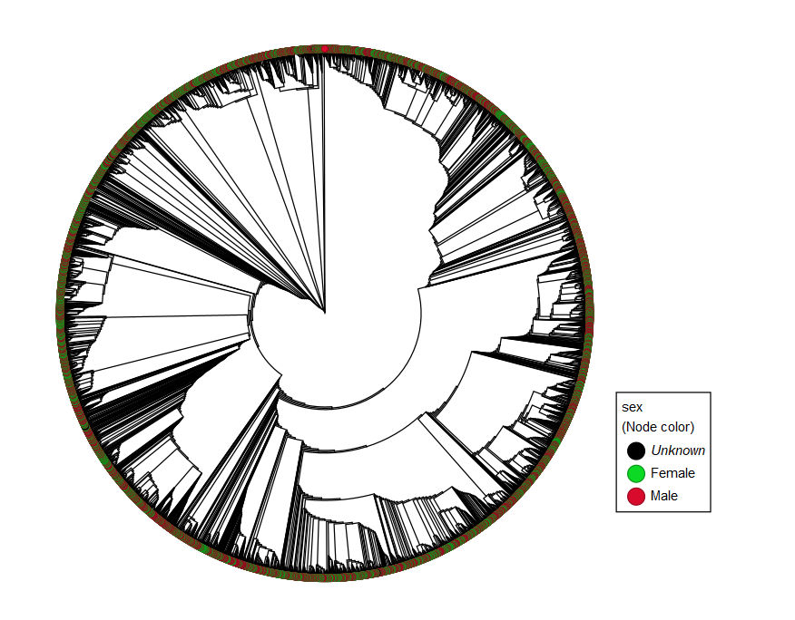
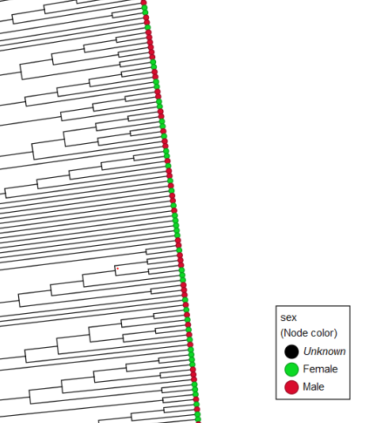
Metadata - age
Notes:
Tosh
Layout options - phylogram, cladogram, circular phylogram, circular cladogram, rooted - unrooted

Slide 11
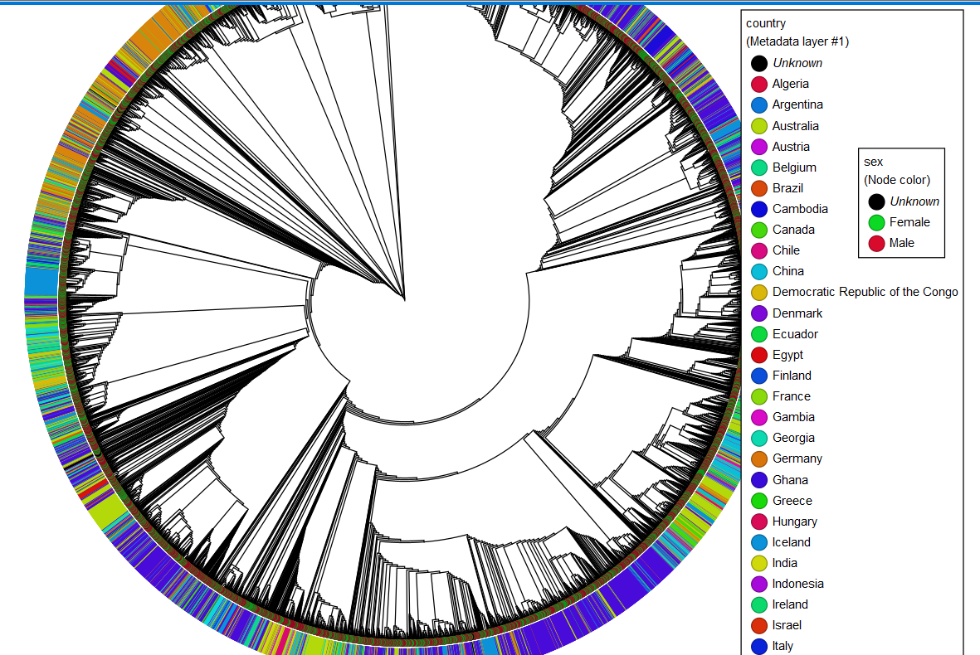
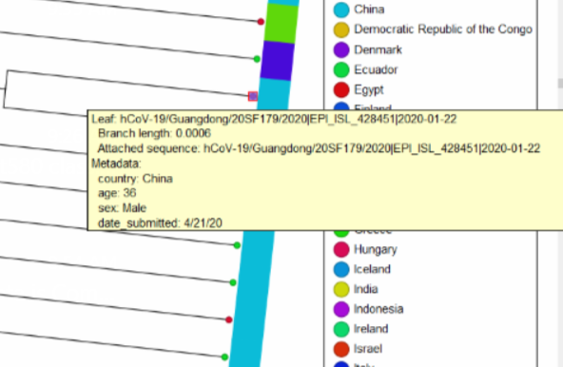
Metadata - Age & Country
Notes:
Tosh

Slide 12
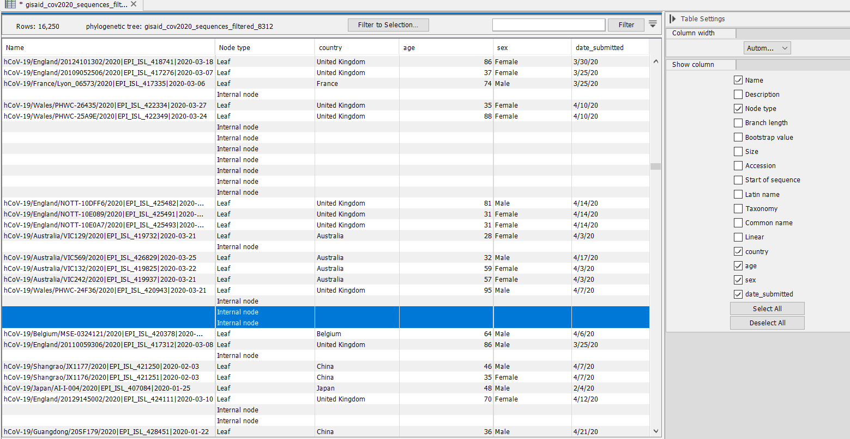
Notes:
Tosh

Slide 13
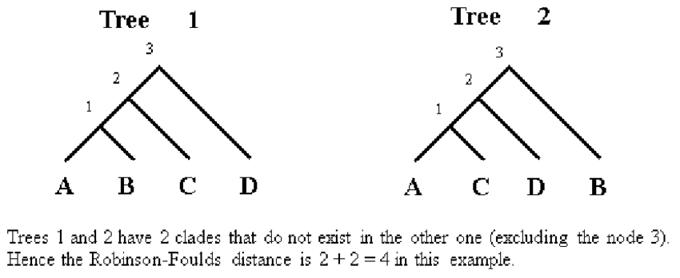
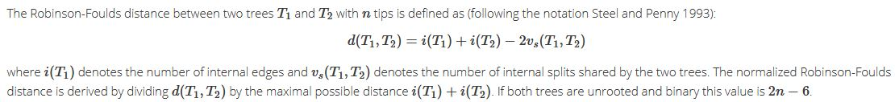
Tree Metrics - Robinson Foulds
Notes:
@Steven
Specifically, the RF supertree problem seeks a binary supertree that minimizes the sum of the RF distances from the supertree to the input trees.

Slide 14
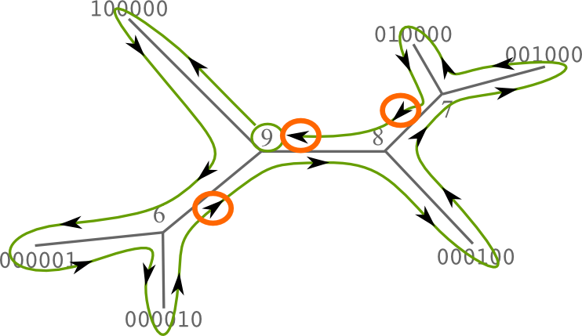
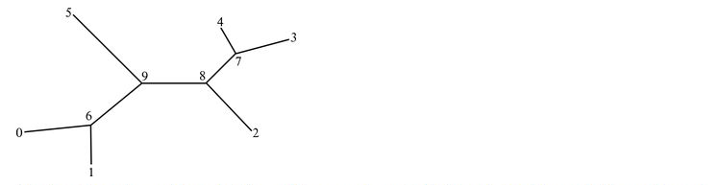
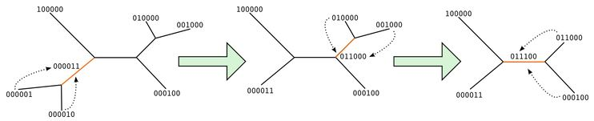
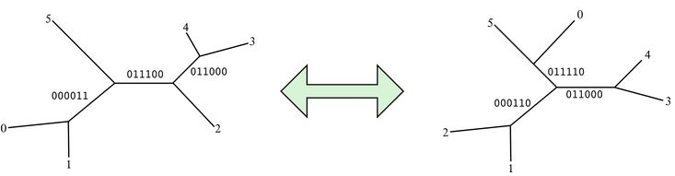
Robinson Foulds
Notes:
@Steven
1. Splitting the tree
The first step is computing the bipartitions (or splits) of each tree. Let's assume we start with the following tree:
Numbers in nodes are the node id's, and there are 2 constraints here in how the node ids must be set:
Node ids must be sequential from 0 to (2n-3), where n is the number of tip nodes.
Ids from 0 to (n-1) are reserved for tip nodes.
Node ids at the tip nodes must agree between both compared trees (i.e., tip i is matched with the same taxon in both trees).
Every branch can split the tip nodes in 2 subsets. Splits on tip branches are called trivial bipartitions. Bits in the split have values '0' or '1', depending on which side of the branch we can find the correspondent tip. There is no direction in this assignment
Next, starting at any arbitrary inner node, we compute a postorder traversal focusing on the inner branches. Inner branches will define our final split set. For each inner branch, we define as children the 2 connected branches that were already traversed. The split at the current branch is the sum, or the logical OR, of the 2 children splits. Next picture shows how the splits are calculated according to the previous traversal descriptor. Finally, we have the set of splits for the current tree. According to the picture above, 000011, 011000 and 011100.
Split normalization
In order to compare them easily, we say that the splits are normalized when a certain position has always the same value.
For example, we can force position of tip 0 (last position) to be always 0 in the bitvectors. Therefore, the 3 splits would be normalized as 111100, 011000 and 011100.
2. Comparing the split sets
Once the split sets for both trees were created and normalized, the Robinson-Foulds distance is the count of the non-shared splits. For example:
We have he following normalized split sets: S(t1) = {111100, 011000, 011100} and S(t2) = {000110, 011110, 011000}. Split 011000 is shared between both trees. The remaining splits are S(t1 x t2) = {111100, 011100, 000110, 011110}. Therefore, the Robinson-Foulds distance between t1 and t2 is 4.

Slide 15
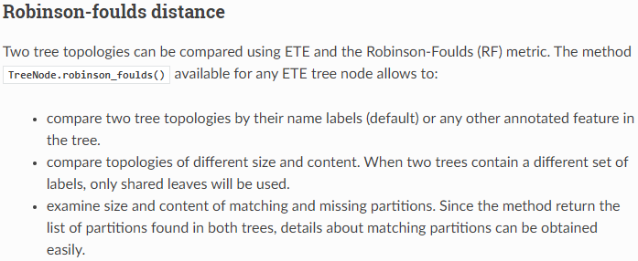
Robinson Foulds Attempts
Notes:
Hoa

Slide 16
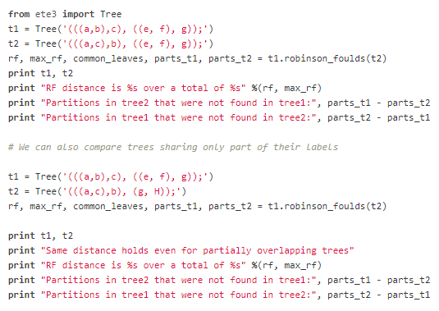
ETE Sample Code
Notes:
Hoa

Slide 17
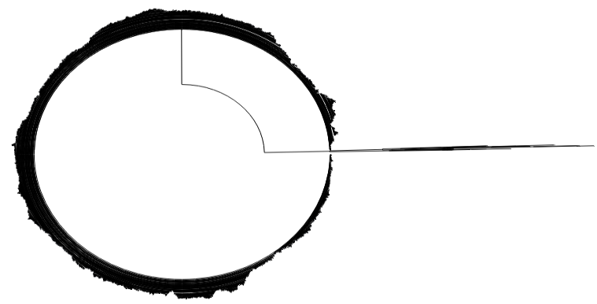
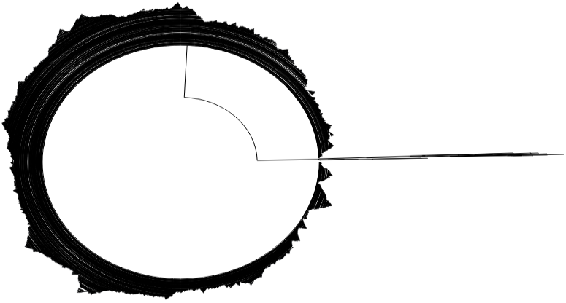

Robinson Foulds Attempts
Fasttree RAxML
Notes:
Hoa

Slide 18
Challenges & Conclusion
Out of date tools
No clear pattern found in our results
Tree too large for tools used
Availability of free tools and their limitations for certain features (CLC workbench free-trial expired after a few days)
Choosing an appropriate metric for the available data
Future work - possibly using metric for lesser data points.
Notes:
@Steven

Slide 19
What we learned
Extracting sequenced dataset
Data alignment
Constructing trees in various ways
Considering different metrics for tree
Viewing and inspecting trees
Notes:
@Steven

Slide 20
References
Cleo Anastassopoulou ,Lucia Russo, Athanasios Tsakris, Constantinos Siettos, journals.plos.org: Data-based analysis, modelling and forecasting of the COVID-19 outbreak, https://doi.org/10.1371/journal.pone.0230405
Fauver, Petrone, Hodcroft, Shioda, Ehrlich, Watts, Vogels, Brito, Alpert,…Ko, Grubaugh, medRxiv preprint : Coast-to-coast spread of SARS-CoV-2 in the United States revealed by genomic epidemiology, https://www.medrxiv.org/content/10.1101/2020.03.25.20043828v1.full.pdf
Oscar Robinson, David Dylus, Christophe Dessimoz, Phylo.io : Interactive Viewing and Comparison of Large Phylogenetic Trees on the Web , Molecular Biology and Evolution, Volume 33, Issue 8, August 2016, Pages 2163–2166, https://doi.org/10.1093/molbev/msw080

